Slide 1
New York City’s Airbnbs
DSC 530 Final Project
Amy Nestingen

Slide 2
Question
Are you able to predict the price of an Airbnb in New York City based on the following criteria
Neighborhood Group (Manhattan, Brooklyn, Queens, etc.)
Neighborhood (Subsets of the Neighborhood Groups)
Room Type (Single Room, Full House, Hotel, etc.)
Minimum Nights
Reviews/Month
Availability to rent out of 365 days

Slide 3
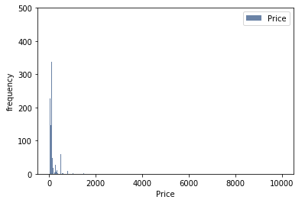
Histogram of Price

Slide 4
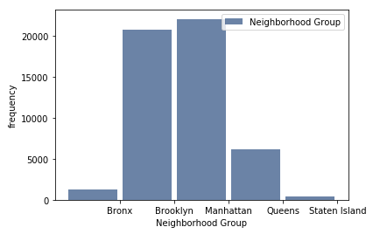
Neighborhood Group

Slide 5
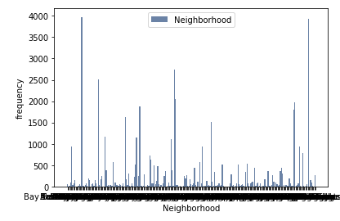
Neighborhood

Slide 6
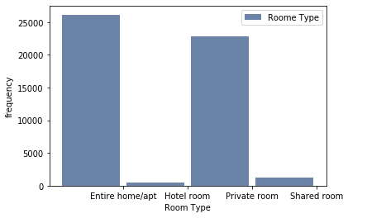
Room Type

Slide 7
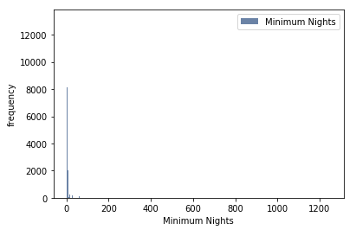
Minimum Nigh Stay

Slide 8
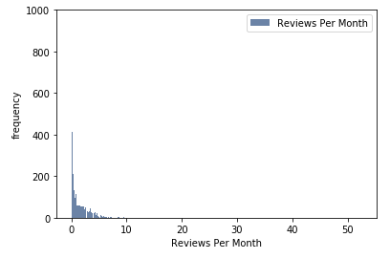
Reviews Per Month

Slide 9
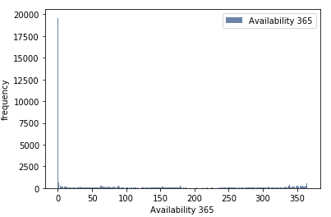
Availability

Slide 10
Outliers
There is an outlier in minimum nights. It is not plausible that the minimum night stay is 1250 nights. This data point will be excluded.
I also want to take out the data points that have availability 365 = 0. If the Airbnb is never available, it should not be included.
There's a long right tail for the Price variable. I decided to only include prices less than 500 and greater than 0.
The following slides are histograms that use the new data set with the outliers removed.

Slide 11
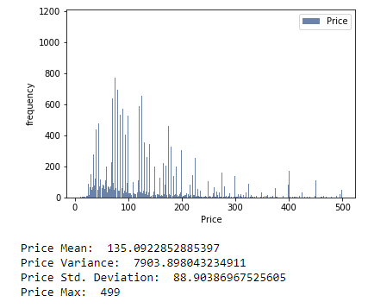
Price
There is generally one mode around $75/night. There are peaks at each number divisible by 10.
The strong outliers have been removed.
The right tail is still very long.

Slide 12
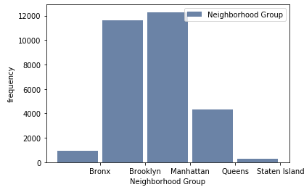
Neighborhood Group
There are considerably more airbnb in Brooklyn and Manhattan compared to Queens, Staten Island, and the Bronx.
There is still enough data in all bouroughs to be included in the analysis.
There are no outliers
This data is nominal so there are no tails.

Slide 13
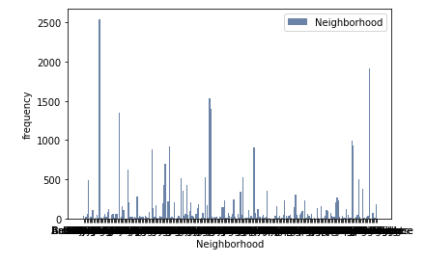
Neighborhood
There are many neighborhoods listed. I believe the peaks in this variable will corespond to the peaks in the Neighborhood group data set.
There are no outliers
This data is nominal so there are no tails.

Slide 14
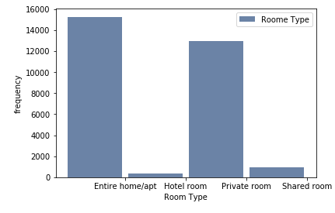
Room Type
There are considerably more airbnbs with a room type of Entire Home/Apt or Private room.
As this analysis goes on, I will decide if it makes sense to include room types of Hotel Room and Shared Room.
There might be outliers in room type as hotel room and shared room.
This data is nominal so there are no tails.

Slide 15
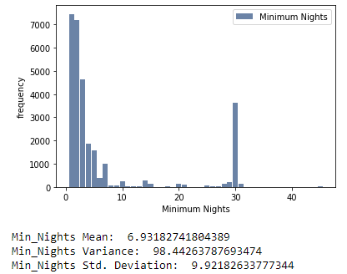
Minimum Night Stay
There are two modes are 1 and 30. This makes me believe that some Airbnbs are rented by the month.
There looks to be on outlier at around 45 nights.
The tails are very long for the variable.

Slide 16
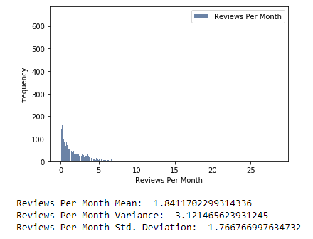
Reviews/Month
The mode is around 0-1 review per month.
There is a strong right skew.
There are possible outliers on the end of the right tail

Slide 17
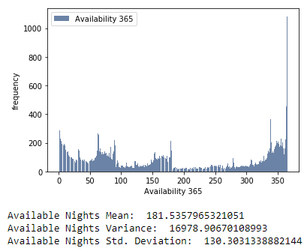
Availability
The most is the max value at 365.
The tail is very long and has slight peaks but I wouldn't call this bimodal.
There are no outliers for this variable.

Slide 18
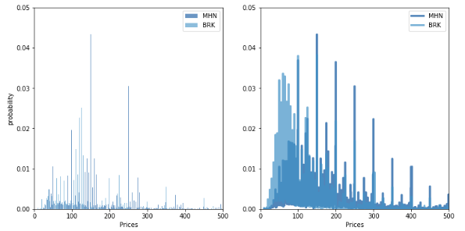
PMF Comparing Manhattan and Brooklyn Airbnb Prices

Slide 19
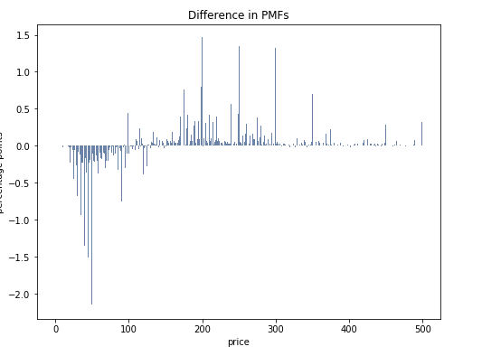
Differences in PMs and Description
The PMF plots show that the distribution for Manhattan airbnb prices are shifted to the right.
Generally airbnbs are more expensive in Manhattan compared to Brooklyn.

Slide 20
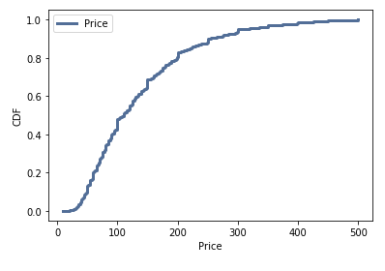
CDF For Price
This graph shows that the price is skewed to the right and the mode is far to the left.
This helps answer the question because there is more data for the lower prices which may mean they are more likely to be acurately predicted.

Slide 21
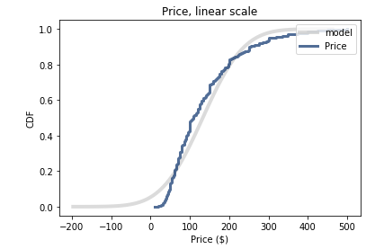
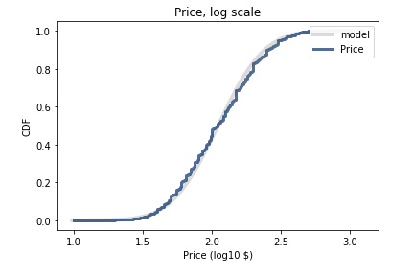
Normal Probability Plot The log scale fits much better than the linear scale. This shows me that I should use a log transformation on price. I tried to incorporate this throughout my project but I feel more confident in my result with the linear scale. Using a log transformation is a skill I will continue to develop.
Linear Scale
Log Scale (This fits much better)

Slide 22
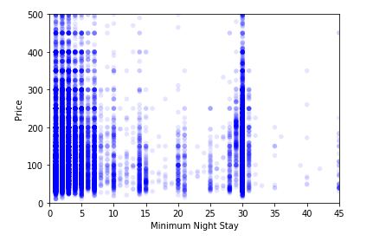
Scatter Plot: Price vs. Minimum Night Stay
I thought that the places with a minimum night stay of 30 would have a lower price/night, but this is not the case. There is a slight downward trend of price/night when minimum night stay increase from 1 to 25. Once the minimum night stay hits 30, the price distribution looks very similar to the distribution when the minimum night stay is 1.

Slide 23
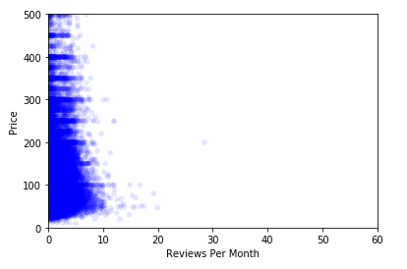
Scatter Plot: Price vs. Reviews Per Month
This scatter plot tells us that the reviews per month are slightly more frequent at the lower price points. This is probably because there are more people that stay at the lower priced Airbnb's. This is an example of causation.

Slide 24
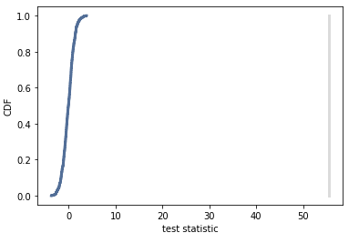
One Side Hypothesis Test: Means
My null hypothesis is that the price/night in Manhattan is not larger than the price/night in Brooklyn
I separated the data into Manhattan Airbnb’s and Brooklyn Airbnb’s.
The p-value was almost 0 so the null hypothesis is rejected.
The average price/night in Manhattan is higher than the average price in Brooklyn.
Distribution of the Difference in Means

Slide 25
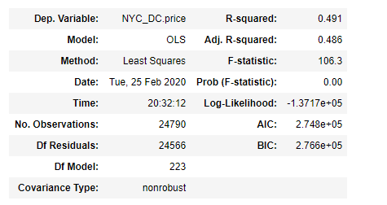
Multiple Linear Regression
I believe the best model to predict the price of an Airbnb in New York city includes Neighborhood, Room Type, Neighborhood Group, Minimum Nights, Reviews per Month, and Availability.
This model had the highest adjusted R-Squared.

